Slide 1

CODE TALKERS
Presentation No.: Final Ppt Group no. : LG-27 DEPARTMENT OF INFORMATION TECHNOLOGY,
KIET GROUP OF INSTITUTIONS, GHAZIABAD, UTTAR PRADESH
(AFFILIATED TO DR. A.P.J. ABDUL KALAM TECHNICAL UNIVERSITY, LUCKNOW, UTTAR PRADESH, INDIA)
Guided by
Ms. Ila Kaushik
Submitted by
Karan Khiani 1602913044
Raghav Sangal 1602913077

Slide 2
Code Talkers
Major Project Presentation
Project ID : LG-27

Slide 3
Objective
A collaborative platform with real time code editor so that you can share what you are coding/ typing on the screen with other people at the same time.
After connecting it to the platform, you can see the changes in your files as your team members type them.

Slide 4
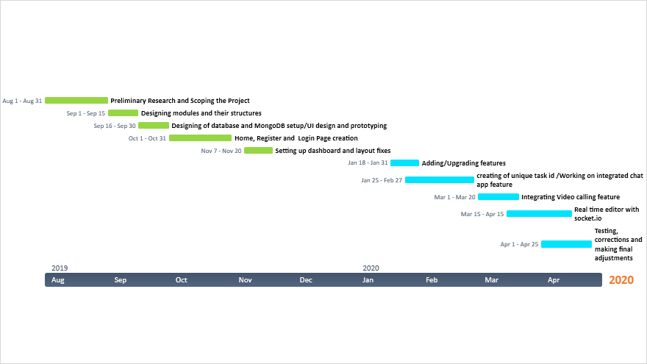
Planning of Work

Slide 5
Features of Code Talkers
Real Time Collaboration
Video Conferencing
Chat with team members

Slide 6
Real Time Collaboration
With our fully collaborative editor multiple users can edit the same files as other users and remain in sync 100% of the time.
The feature of real time collaboration is integrated through operational technologies. This feature is implemented using Ot.js
CodeTalkers is built on javascript. Significant logic is shared between client and server for coding in javascript.

Slide 7
Video Conferencing & Text Chat
We have built-in multi person video and text chat to the side of the editor for easy communication process among members.
This feature is implemented using socket.io which enables event-based communication.

Slide 8
Stack Used
Frontend :
HTML , CSS , Bootstrap , Javascript
Backend :
Node.js, Socket.io,
Database :
MongoDB

Slide 9
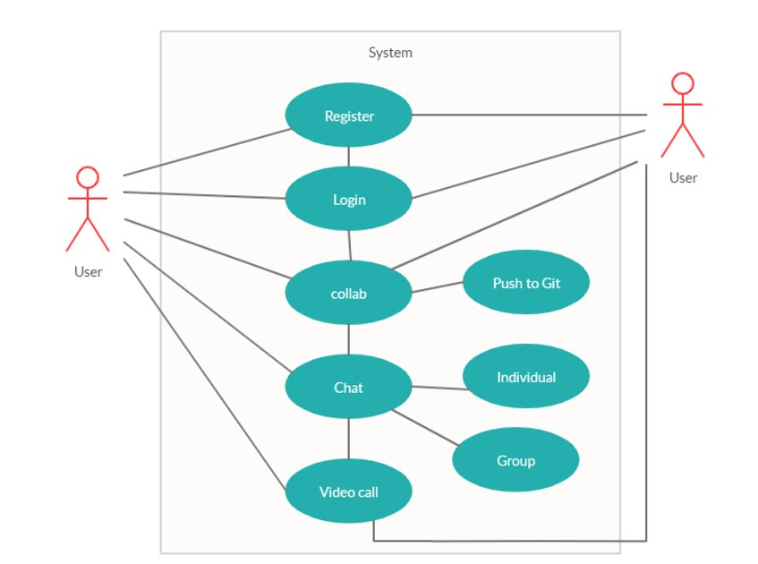
Use Case Diagram

Slide 10
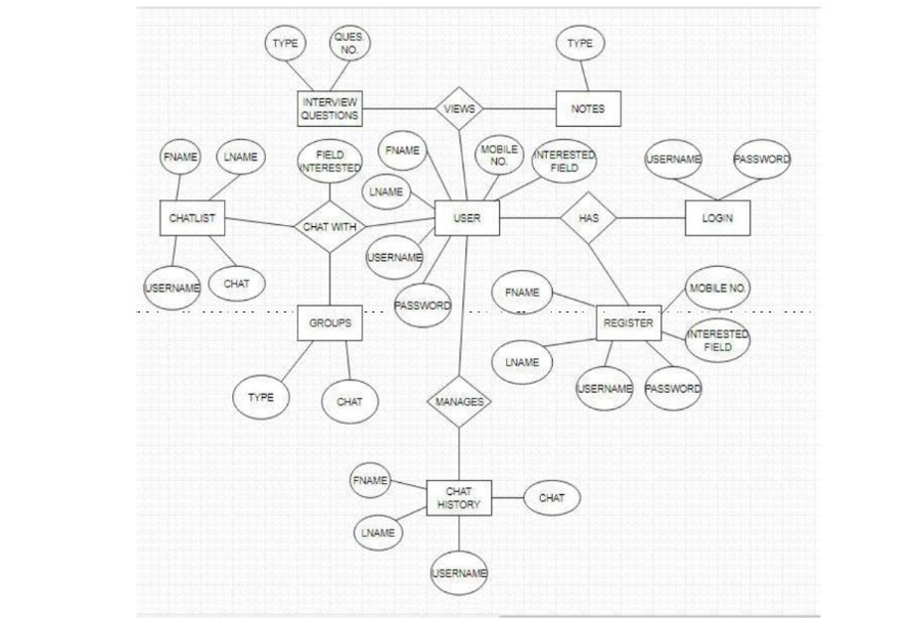
ER Diagram

Slide 11
Process flow of Code Talkers
What is CodeTalkers?
Learn features
Start Task
Login
Enjoy CodeTalkers
Collaborate with editor
Register if not a member
Communicate using video/chat
Enter CodeTalkers

Slide 12
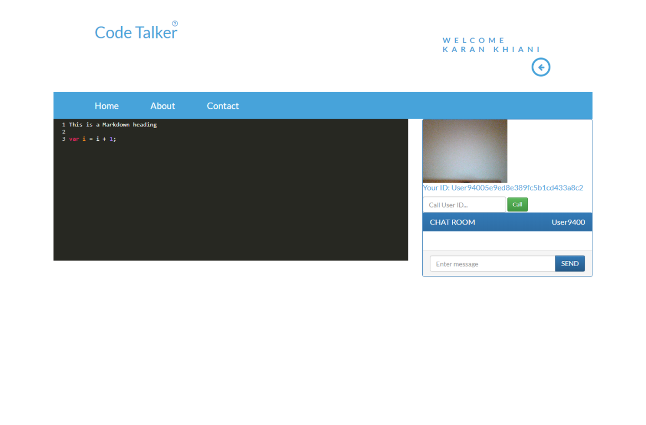
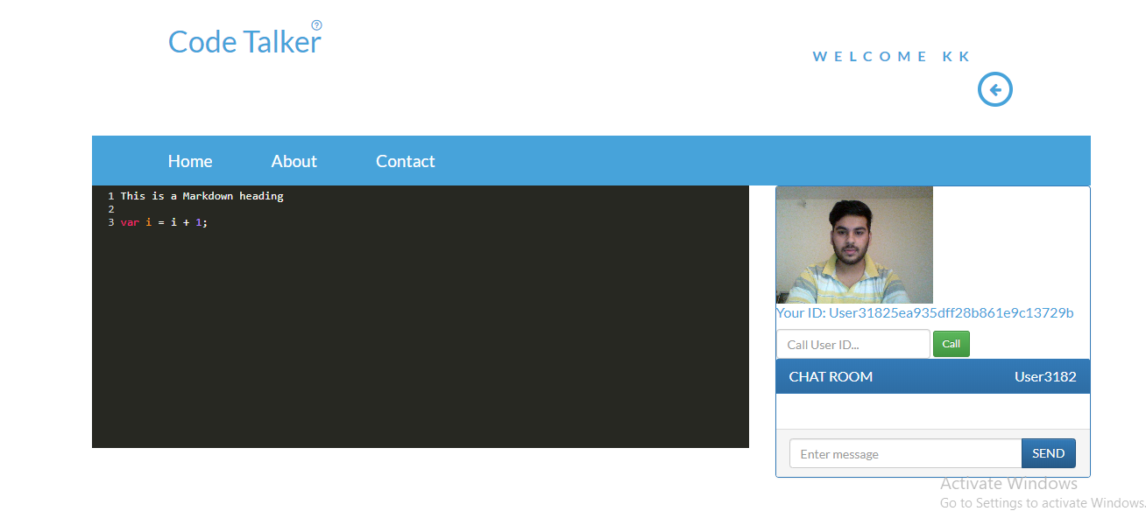
Working of CodeTalkers
Screen 1
Screen 2

Slide 13
Conclusion
The development of application was completed successfully.
Authentication was done using passportJS.
The user can work with another user using real-time editor.
Video Calling and Chat feature makes the users more interactive.
The web application has a simple user interface.
Testing has been done to ensure proper working of web application.

Slide 14
References
[1] Node http://nodejs.org/en/docs
[2] Javascript https://developer.mozilla.org/en-us/docs/web/javascript
[3] MongoDB https://docs.mongodb.com/
[4] Socket.io https://socket.io/docs/
[5] PassportJs http://www.passportjs.org/docs/downloads/html/
[6] OT.js http://operational-transformation.github.io/
[7] Codemirror https://codemirror.net/doc/manual.html

Slide 15
References
[8] Css https://developer.mozilla.org/en-us/docs/web/css/reference
[9] Express https://devdocs.io/express/
[10] StackOverflow https://stackoverflow.com/
[12] Developers google https://developers.google.com /
[13] Github https://help.github.com/en
[14] Jquery https://api.jquery.com/
[15] https://www.simplifiedcoding.net/

Slide 16
Thank You
BY:
Karan khiani (1602913044)
Raghav sangal (1602913077)

